Slide 1

From Swimming Upstream to Streamlining: Process Improvements with the Sierra Database
Michelle Gerry Sue Rahnema
Beth Snapp Ousmane Kebe

Slide 2
Overview
Case studies
Users & Permissions
Course Reserve Lookup
Lending Report
For each case study:
Describe task
Old way with Millennium
New solution using Sierra database
Q&A

Slide 3
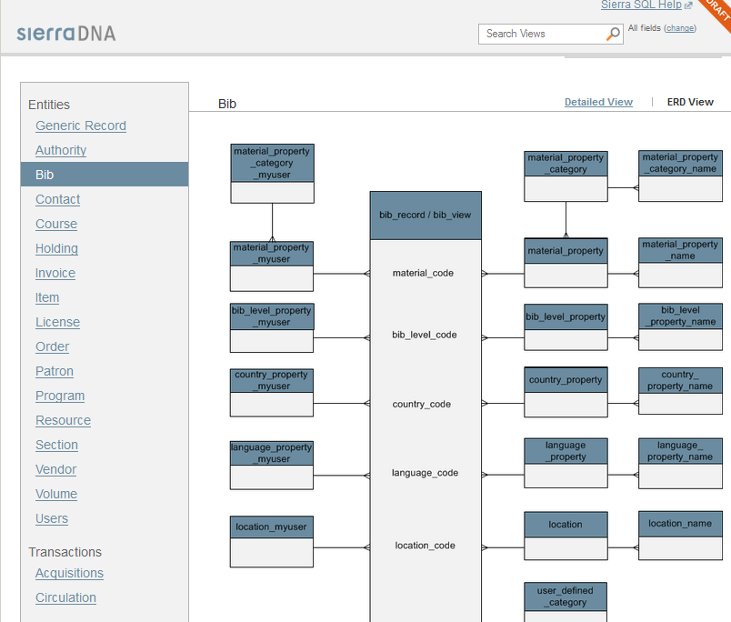
Sierra DNA
Database Access
PostgreSQL
Read only
Relational
> 300 views
http://techdocs.iii.com/sierradna

Slide 4


Who we are
The Ohio State University Libraries
Columbus, Ohio
67,000 students
7 million volumes
13 locations
346 employees
Sierra
Software only
June 2013
475 users
library.osu.edu

Slide 5
Case Study #1: Users & Permissions
User Maintenance
Large Number of Users
Over 450 Individual and Shared Users
Keeping up with change
Maintaining Security Best Practices
Routine IT Systems Audit
Partnerships with Human Resources

Slide 6
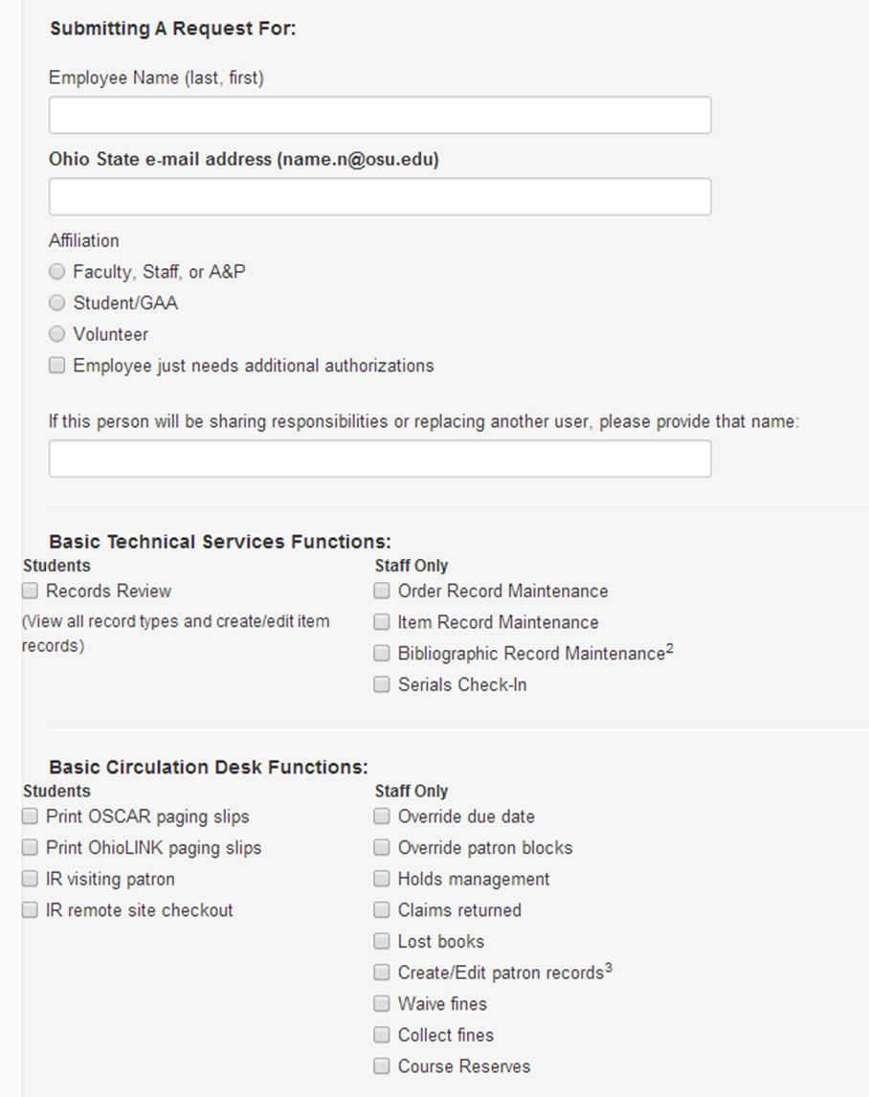

Slide 7
The Old Way in Millennium
Millennium Site
SSH client authorizations
Problems with this method
Lengthy process
Difficulty comparing user permissions
Costly

Slide 8
Challenges
Downloading a usable list
Users
Maintain system security
Permissions
Monitor restricted permissions
Function restrictions during Fiscal Close
Comparison of users
Side-by-side comparison

Slide 9
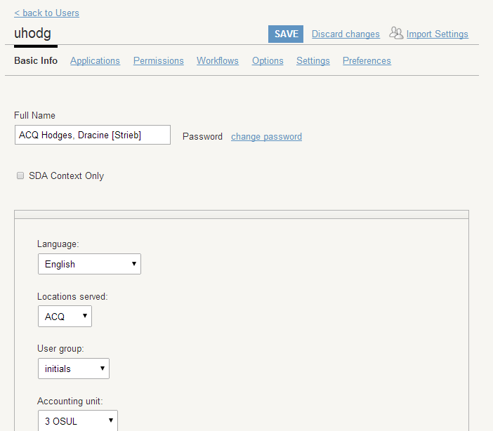

Slide 10
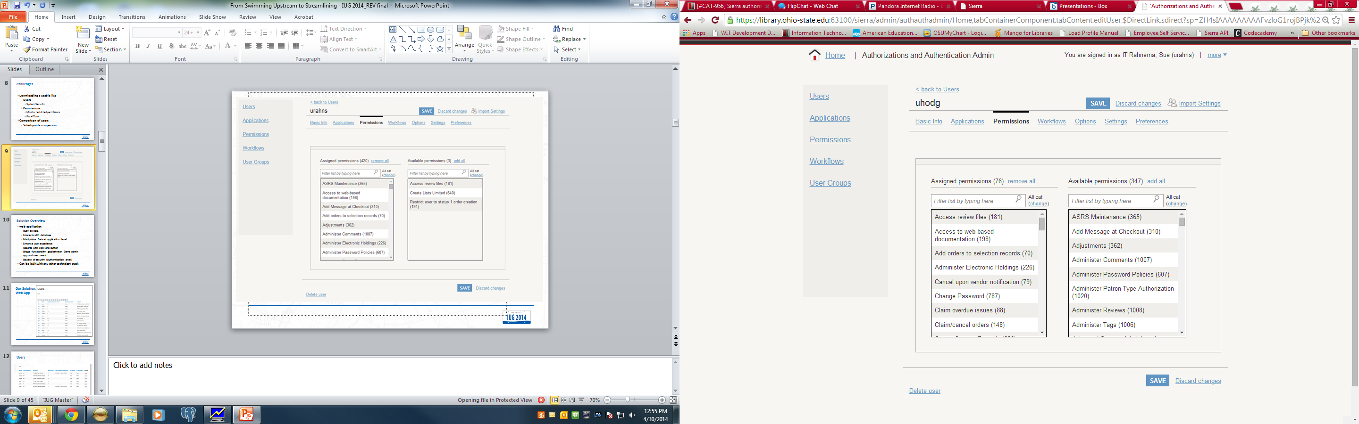

Slide 11
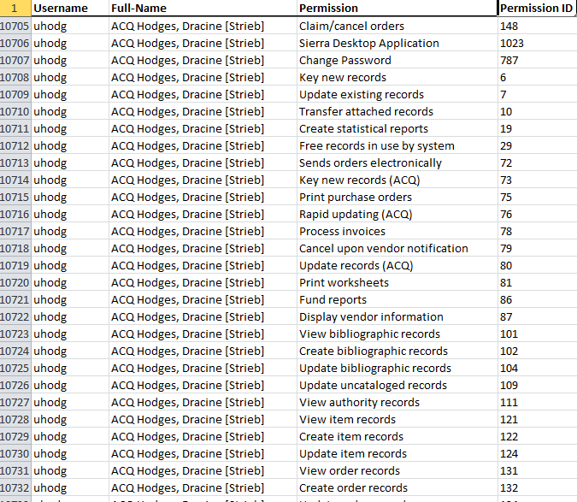

Slide 12
Solution Overview
Web application
Ruby on Rails
Can use any other technology stack
Manipulate data at application level
Enhance user experience
Reports with click of a button
Bridge functionality gap between Sierra admin app and user needs
Beware of security (authentication layer)

Slide 13
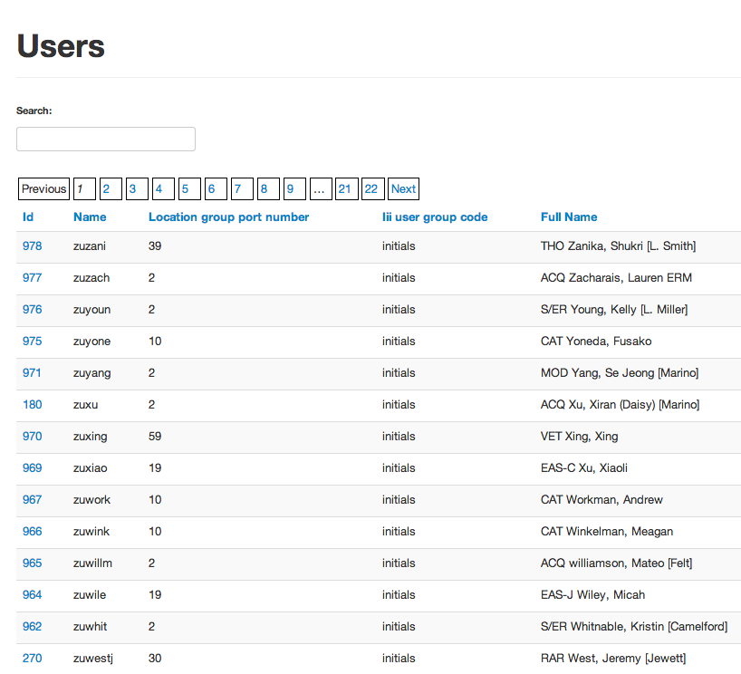
Our Solution: Web App

Slide 14
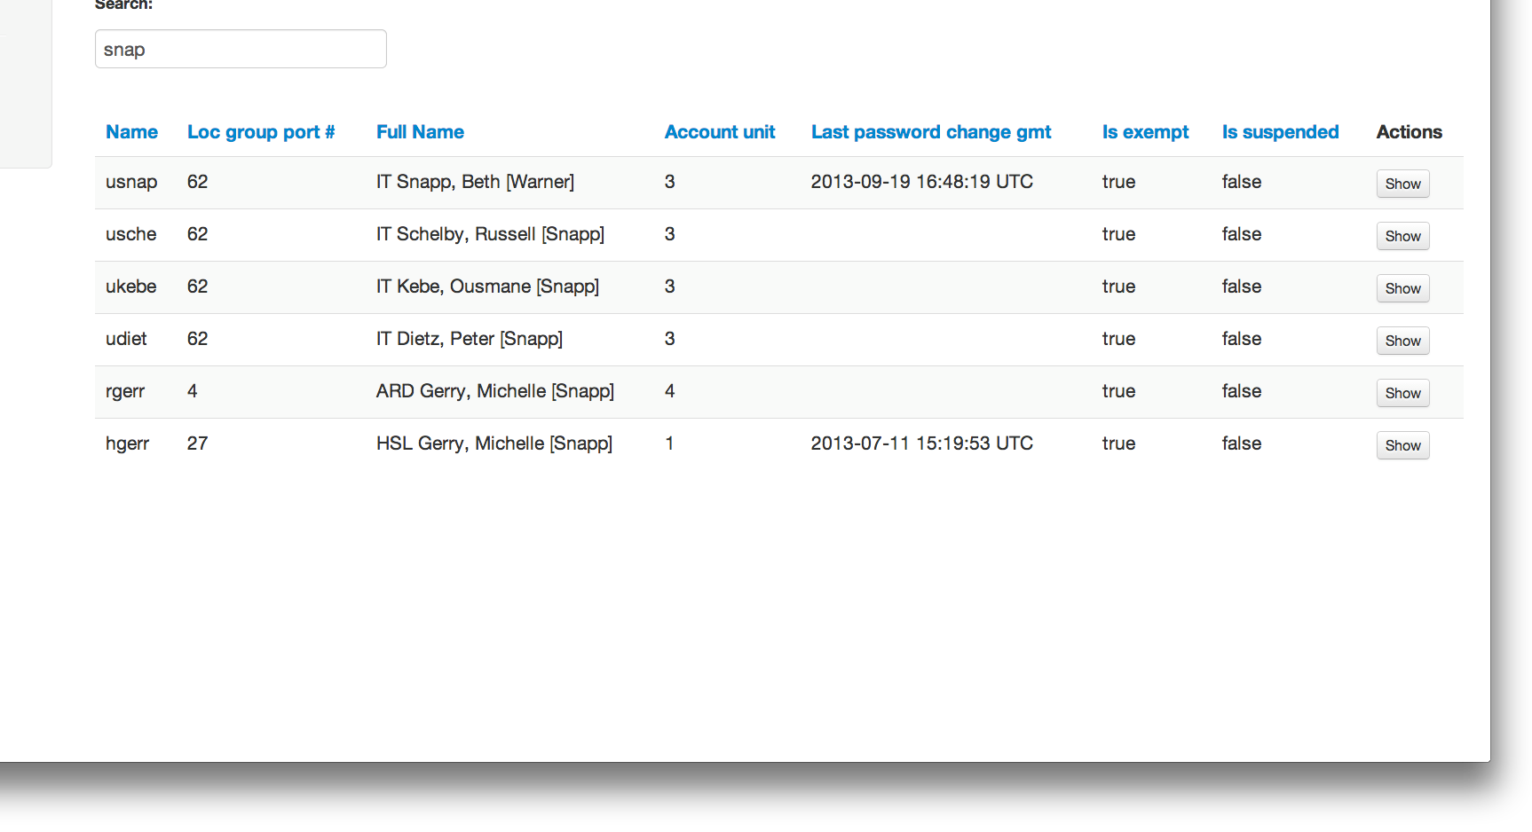
Users

Slide 15
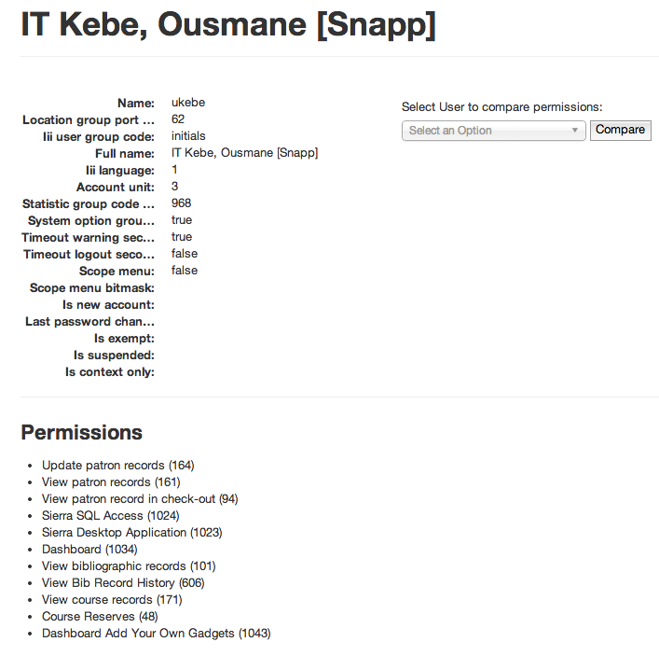
User Detail

Slide 16
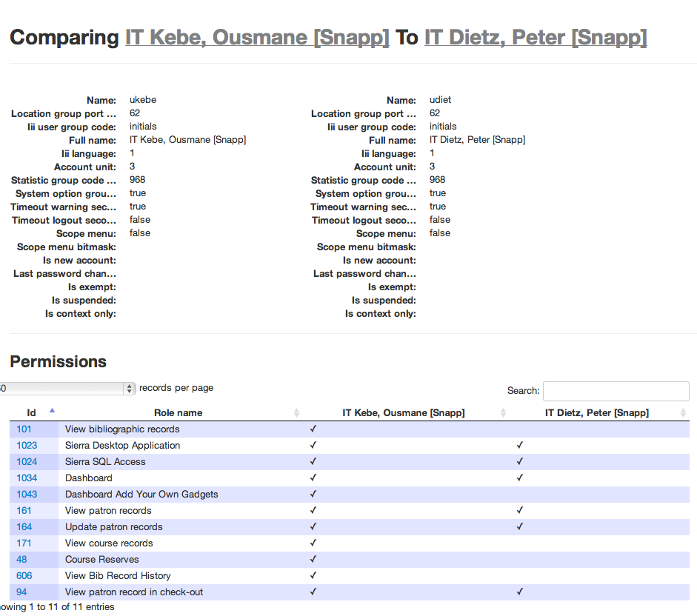
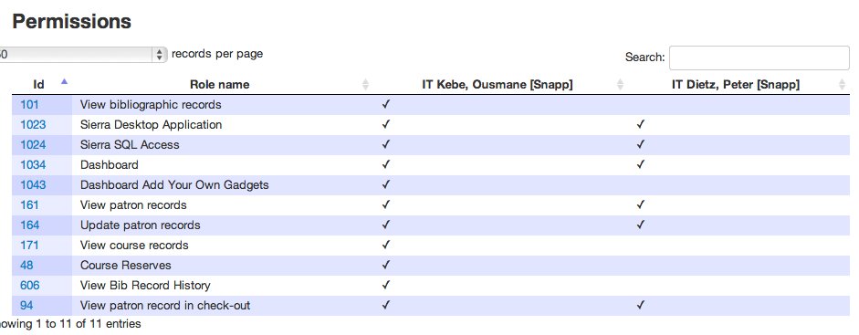
Compare Permissions

Slide 17
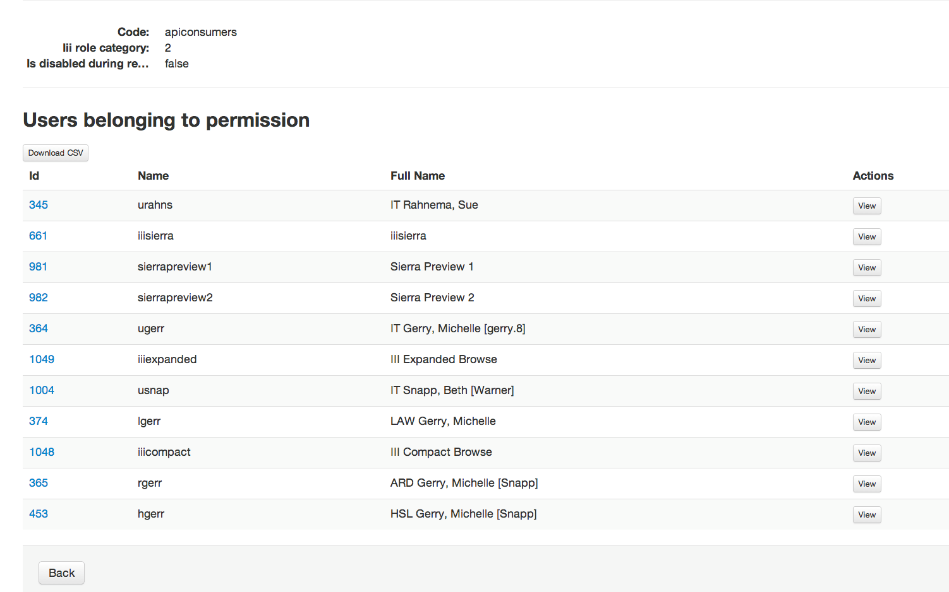
Permissions

Slide 18
Benefits of New Solution
Saves time
Reduced number of users
Sorting permissions in compare mode
Download permissions
Lead time is reduced to set up a new employee
Real time data
Improved system security

Slide 19
Case Study #2: Course Reserves Lookup
Reserve Shelf Lists
Our first foray into Sierra DNA
Locations with Reserve Shelves in Call # order
Create Lists complications
Notes:
One of our libraries that mainly serves science and engineering students used a different method for course reserves: retrieving the materials by call number order only. They default course reserve search from the library catalog didn’t meet their needs for various reasons.
Typically one staff member would end up manually update a spreadsheet with the key information. The staff member asked us if there was a way to better automate this process. My initial attempts using Create Lists were still fairly labor intensive.

Slide 20
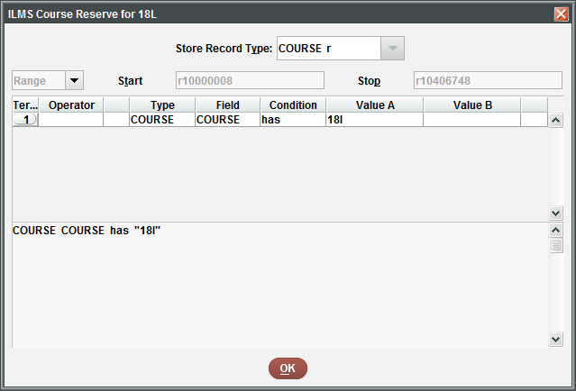
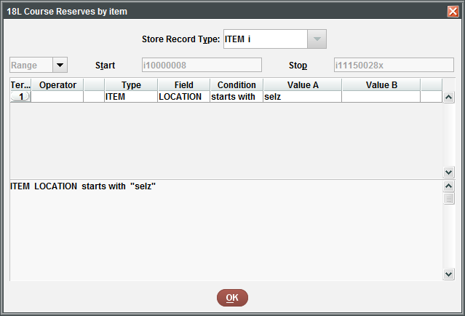
Two Create Lists to Merge
COURSE
ITEM
Notes:
In order to find the link between course, item and bib records, I ran two separate review files, one querying course records, and another for item records based on criteria provided by the library.

Slide 21
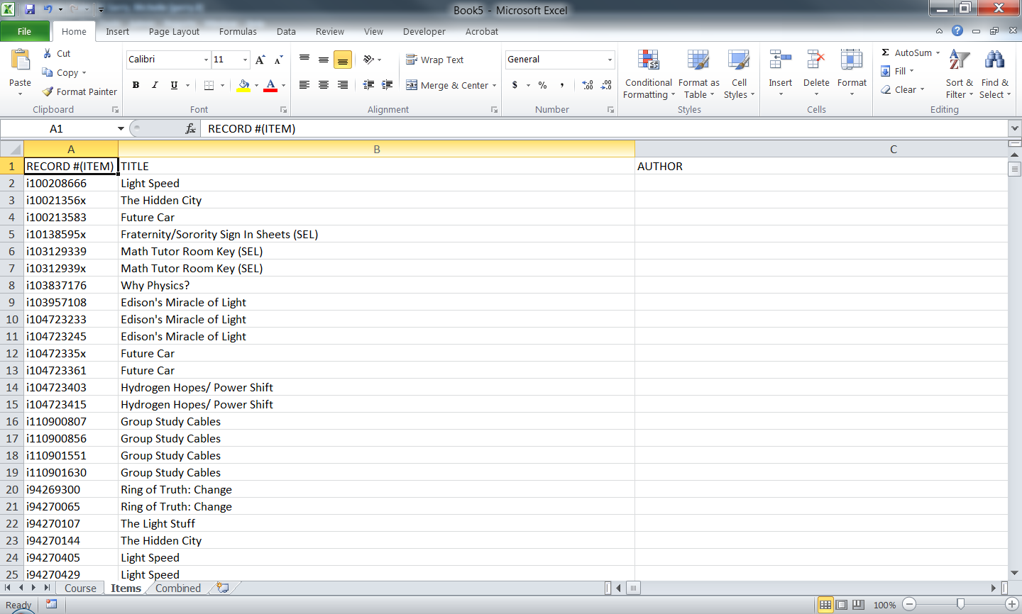
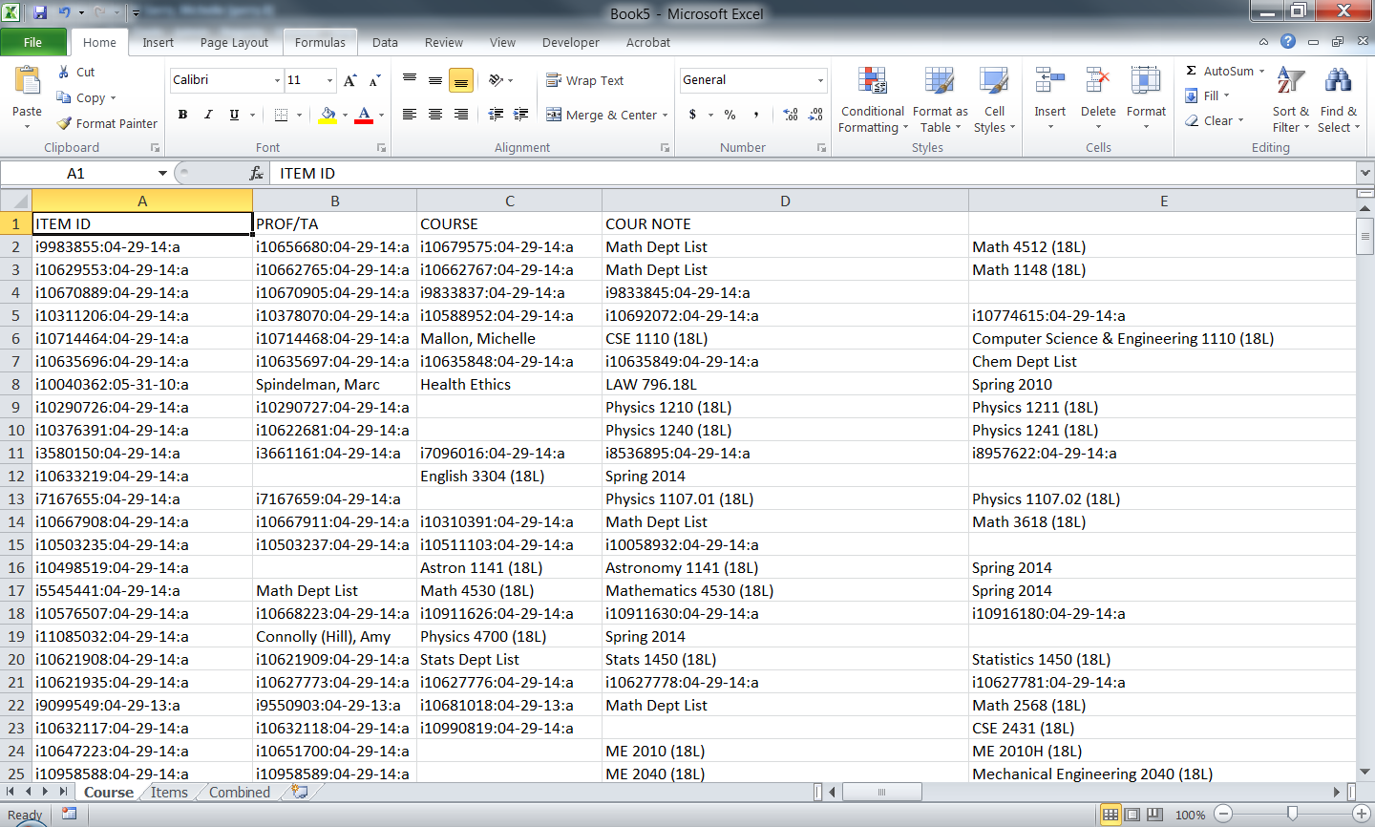
Match and merge the files on the Item ID
Notes:
I output specific fields from each review file and linked them together based in item record number using the INDEX function in Excel.

Slide 22
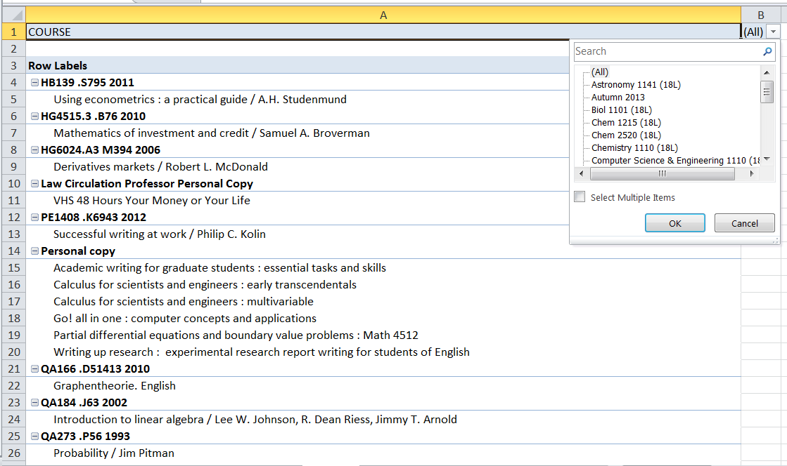
Pivot Table after much manipulation of data
Notes:
And from there created a pivot table that allowed staff and students to filter by course number. It was still a very clunky solution, and didn’t allow for dynamic updates, which was what the staff member really wanted. Ousmane will now explain how he found a better solution.

Slide 23
Solutions Overview
Web Tool
SQL query
Gadgetize
Embed in Sierra Dashboard
Be cautious about security
More on dashboard: http://csdirect.iii.com/sierra/kb/article.php?cat_id=22&typ_id=4&art_id=6

Slide 24
Our Solution: Sierra Dashboard Gadget (sql query)
SELECT DISTINCT on (coursetitle.field_content, itemtitle.field_content, callnumber.field_content)
UPPER(replace(coursetitle.field_content, ' (18L)', '')) as course,
itemtitle.field_content as title,
replace(replace(replace(COALESCE(max(itemcallnumber.field_content), callnumber.field_content), '|a', ''), '|b', ' '), '|c', ' ') as callnumber
FROM sierra_view.course_record c
JOIN sierra_view.course_record_item_record_link ci ON ci.course_record_id = c.record_id
JOIN sierra_view.item_view i ON ci.item_record_id = i.id
JOIN sierra_view.bib_record_item_record_link bi ON bi.item_record_id = ci.item_record_id
JOIN sierra_view.varfield itemtitle ON itemtitle.record_id = bi.bib_record_id and itemtitle.varfield_type_code = 't'
LEFT OUTER JOIN sierra_view.varfield itemcallnumber ON itemcallnumber.record_id = i.id and itemcallnumber.varfield_type_code = 'c' and itemcallnumber.marc_tag = '090'
JOIN sierra_view.varfield callnumber ON callnumber.record_id = bi.bib_record_id and callnumber.varfield_type_code = 'c'
JOIN sierra_view.varfield coursetitle ON coursetitle.record_id = c.record_id and coursetitle.varfield_type_code = 'r' --and coursetitle.occ_num = 0
WHERE c.location_code = 'sel'
GROUP BY coursetitle.field_content, itemtitle.field_content, callnumber.field_content
ORDER BY coursetitle.field_content, itemtitle.field_content, callnumber.field_content

Slide 25
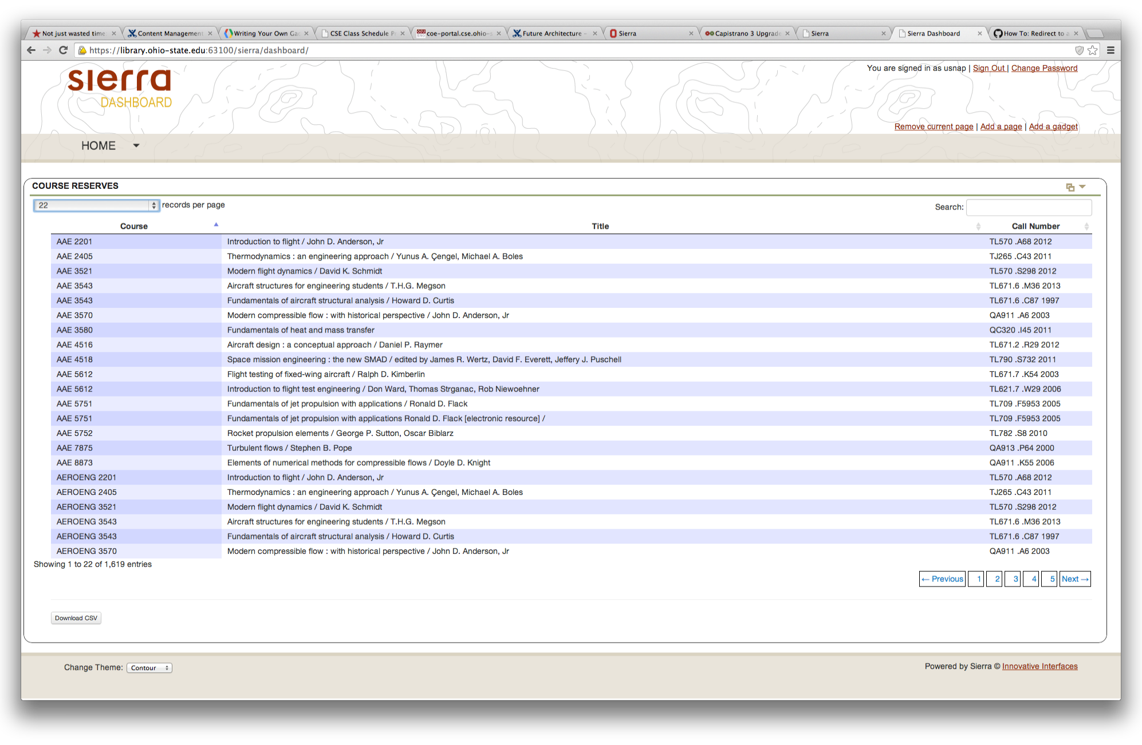
Our Solution: Sierra Dashboard Gadget

Slide 26
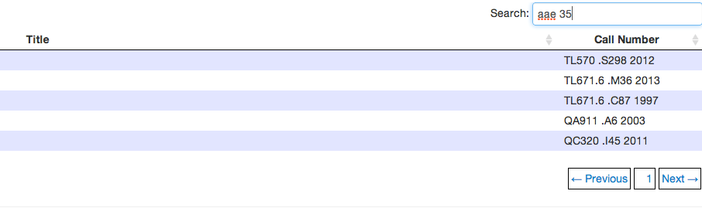
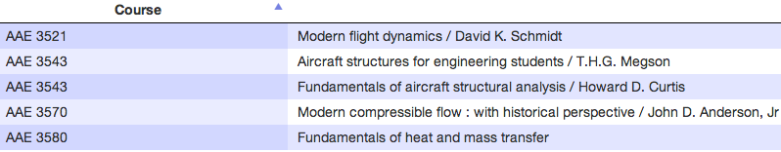
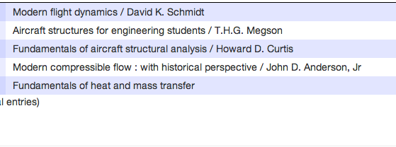
Our Solution: Sierra Dashboard Gadget

Slide 27
Benefits of the New Solution
No more paper reports
Live data is more accurate
Improved user experience
Save staff time
Notes:
A way to help people who are stuck in a certain routine to think differently about their processes, and see it in a new light.

Slide 28


Case Study #3: Non-local Lending Report
OhioLINK/SearchOhio Lending Statistics
Request from Collection Strategist: What EXACTLY are we loaning to other INN-Reach member libraries?
Call number?
Format?
Language?
Notes:
More detail about purpose of report and issues involved in gathering it

Slide 29
The Old Way in Millennium
Um, there was no old way ☺

Slide 30
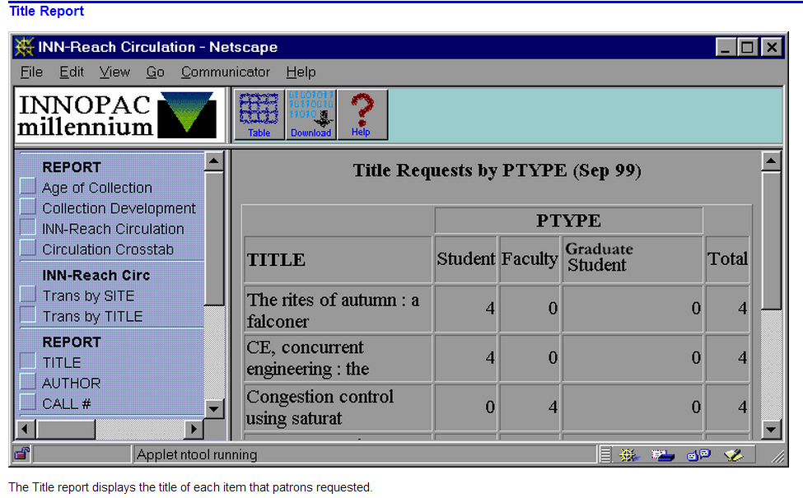
Web Management Reports – requests ONLY
http://csdirect.iii.com/manual/ir_local_transactions_by_title.html
(Page # 105051)

Slide 31
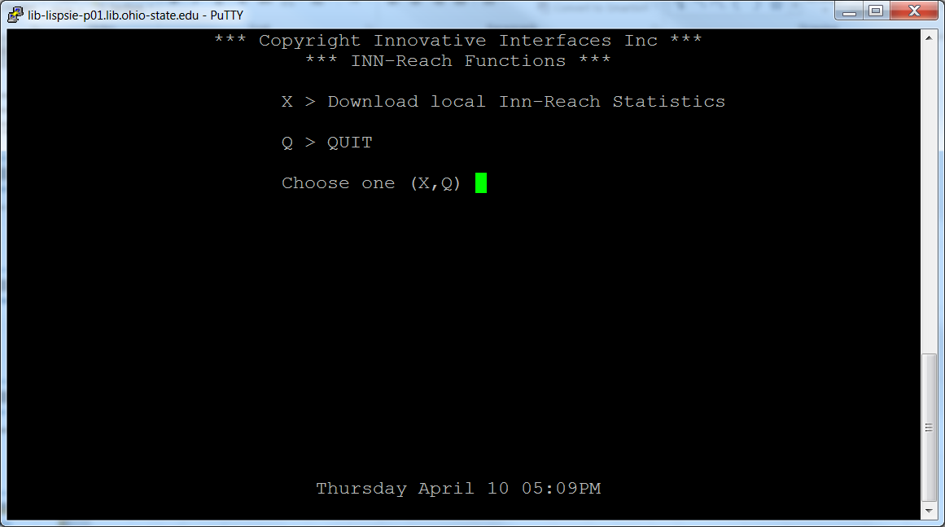
Character-based System

Slide 32
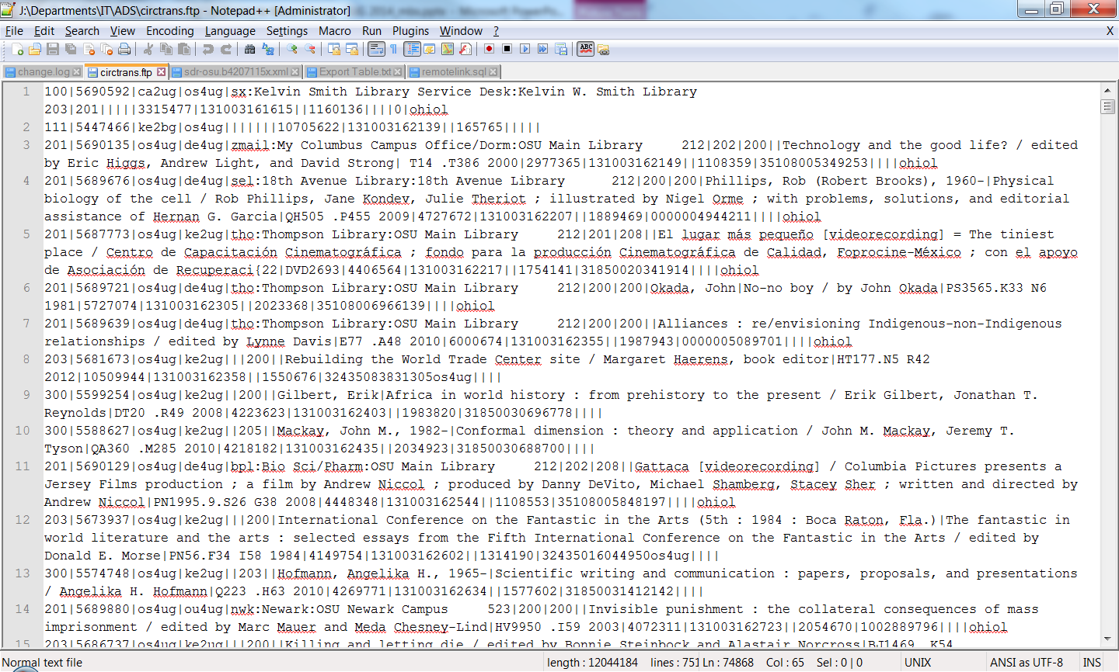
FTP Transactions

Slide 33
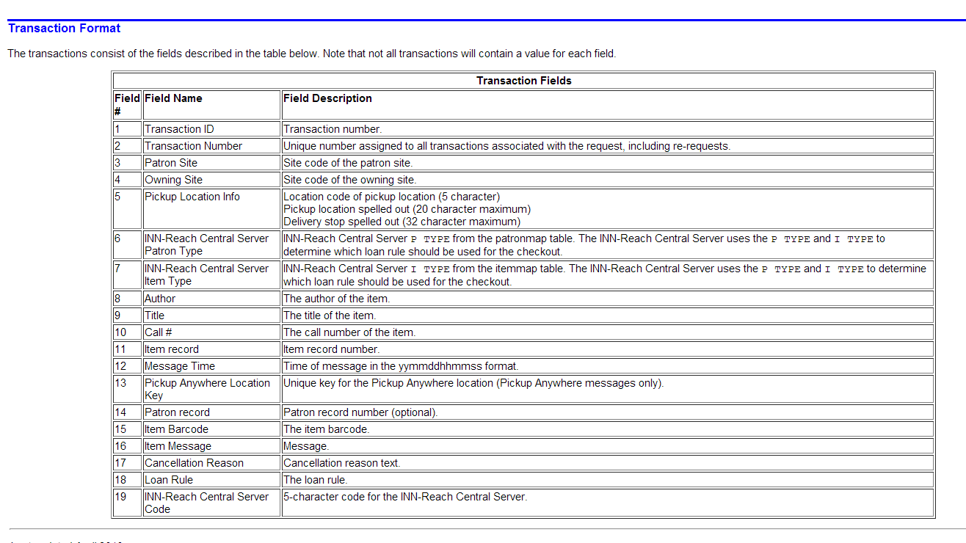
Match with Field Names
http://csdirect.iii.com/manual/ir_local_export_trans.html (Page # 106028)

Slide 34
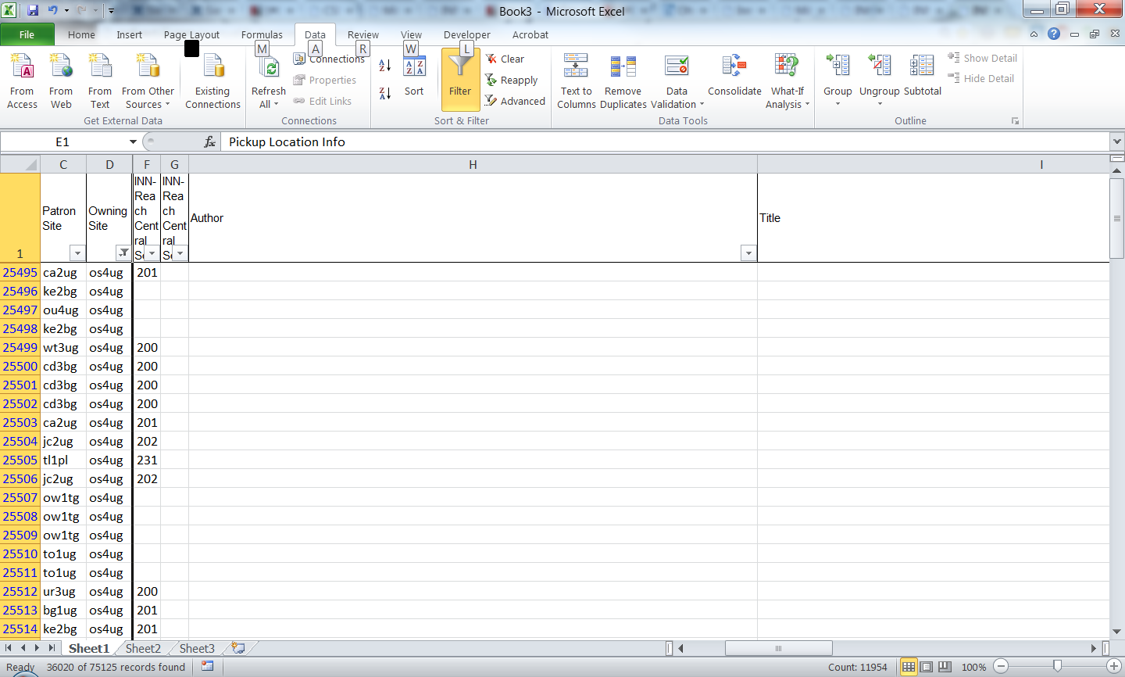
Import into Excel
Call Number? Format?
Where is the…
Title? Publisher?

Slide 35
Our Solution: PostgreSQL Remote Link*
SQL Query
Views
Download
Data Subset
Local Table
Join
Sierra Database
Local Database
Remote Link
(via PostgreSQL FDW)
* Be cautious about performance: download only what you need

Slide 36
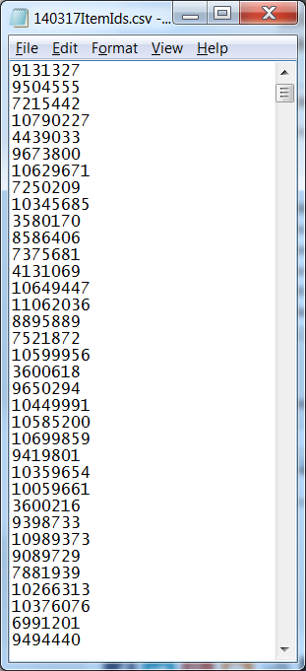
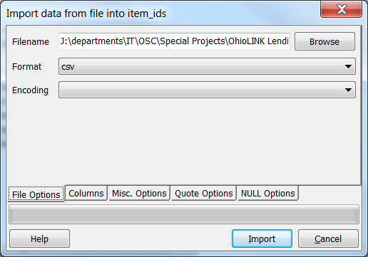
Our Solution: PostgreSQL Remote Link
Views
Local Table
Import
Sierra Database
Local Database

Slide 37
Our Solution: PostgreSQL Remote Link*
Export
SQL Query
The Data You Need
Views
Download
Data Subset
Local Table
Join
Sierra Database
Local Database
Remote Link
(via PostgreSQL FDW)
* Be cautious about performance: download only what you need

Slide 38
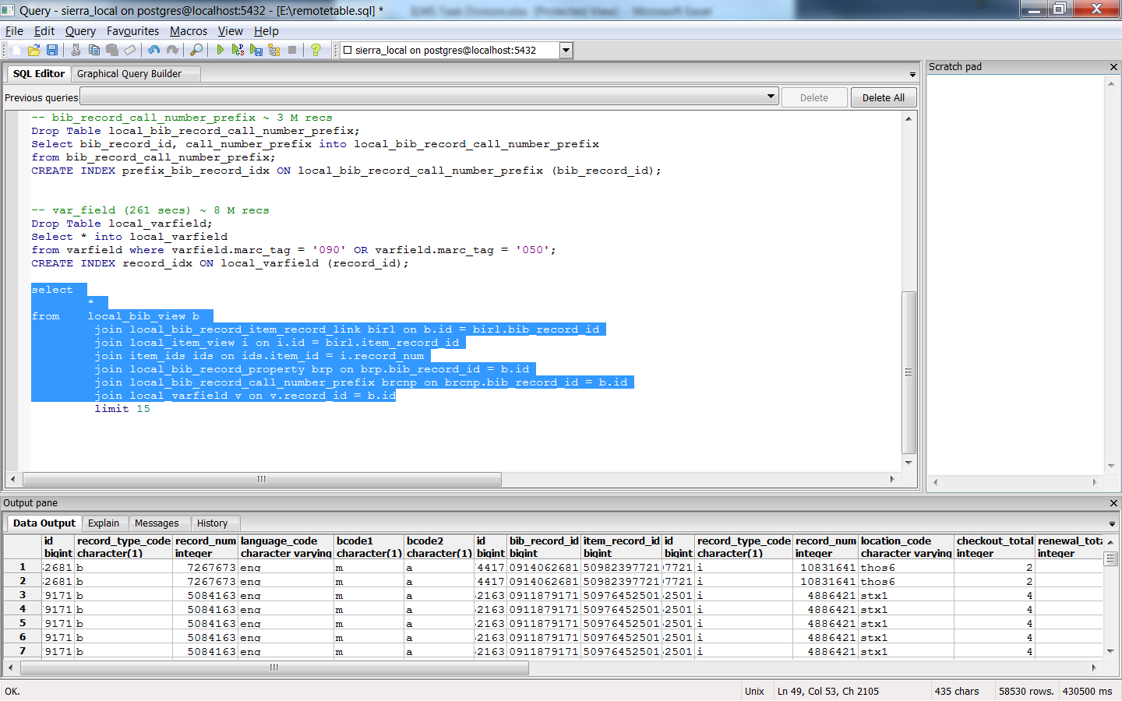
Join local table and item_ids

Slide 39
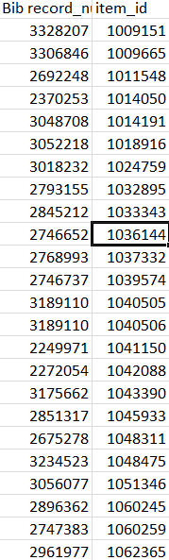
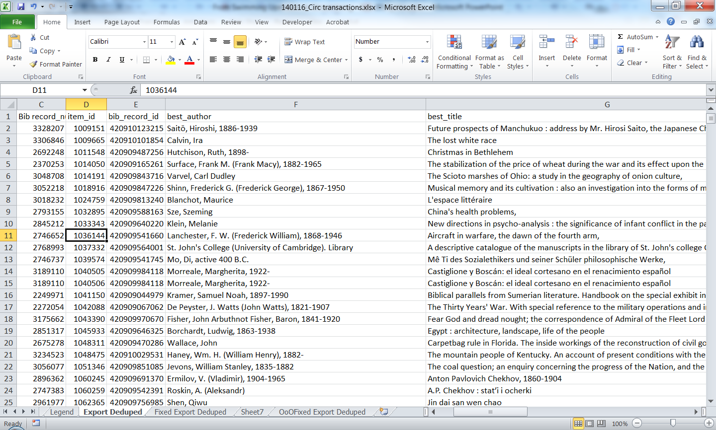
Our Solution: Remote Connection
Bib Record Content

Slide 40
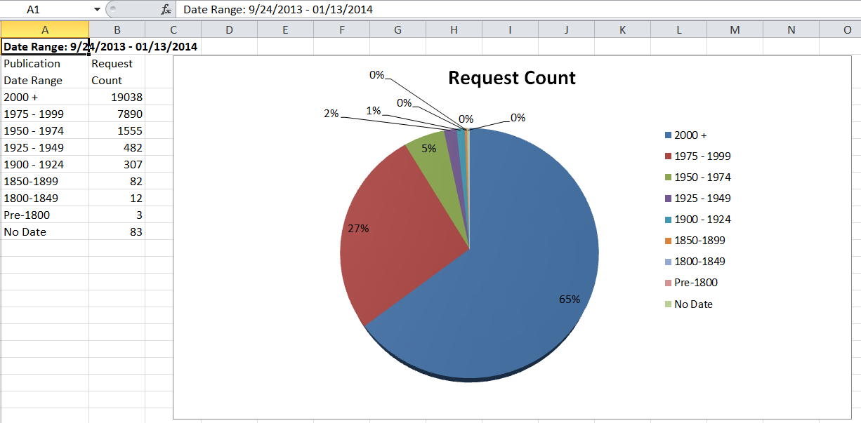
Reporting by Publication Date

Slide 41
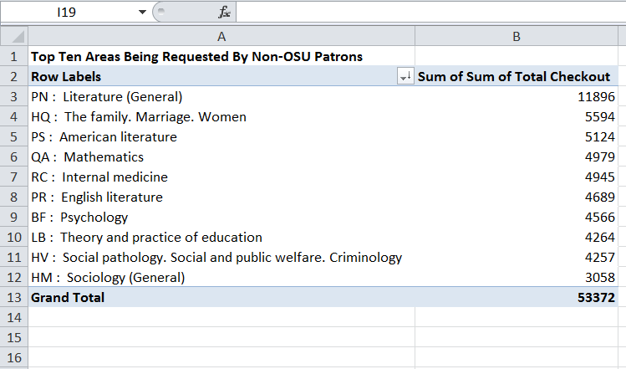
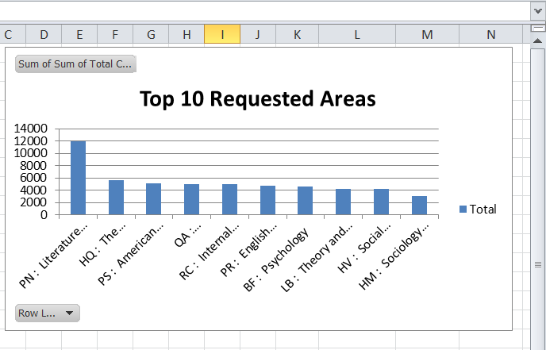
Reporting by Library of Congress Classification

Slide 42
Top Five Borrowers

Slide 43
Benefits of the New Solution
Provide heretofore unavailable statistics to collection strategist
Save staff time/frustration
Meeting deadlines more quickly

Slide 44


What’s on the horizon
Further web/mobile app development*
Reporting dashboard
Sierra API
*Course Reserve icon via Caly Poly Pomona University Library site
Notes:
We are part of the Sierra API beta testing team

Slide 45
Thank you!
Beth Snapp (snapp.6@osu.edu)
Michelle Gerry (gerry.8@osu.edu)
Sue Rahnema (rahnema.3@osu.edu)
For more info on technical solutions, contact Ousmane Kebe (kebe.4@osu.edu)

Slide 46
Thank You!
Thank You!

